Slide 1
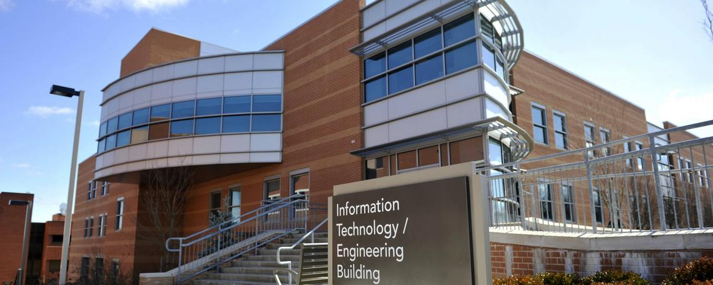

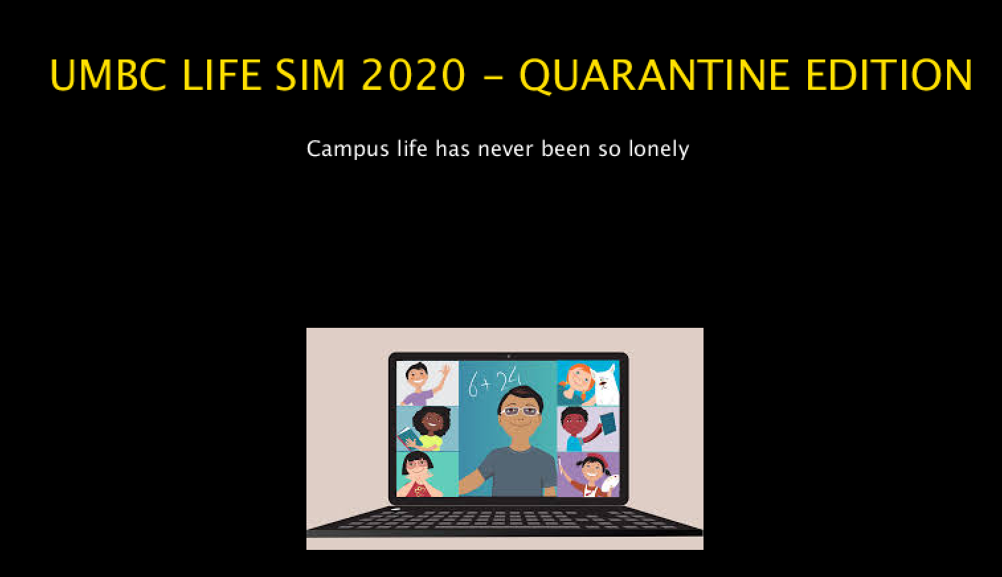
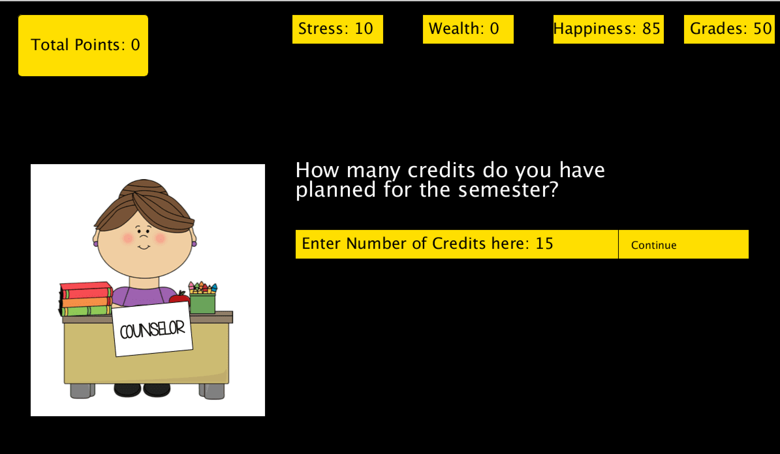
COMP101Y - Fall 2020
Group 14
BOHN
Sriram Batchu
David Onwonga
Richard Ho
Mark Nay
UMBC Life Sim 2020: Quarantine Edition
Campus life has never been so lonely
Problem:
High school students need a way to acclimate easier to college life
Game Features:
Choose how you live the college life
Events that change the outcome of the semester
Your score is tallied at the end
Experience the hybrid class style college life
Benefits:
Able to apply in the game to real life situation
Improve decision making
Time managements,
Critical thinking
Solution:
The game puts students through various scenarios to help them understand opportunity cost and college life

